Slide 1
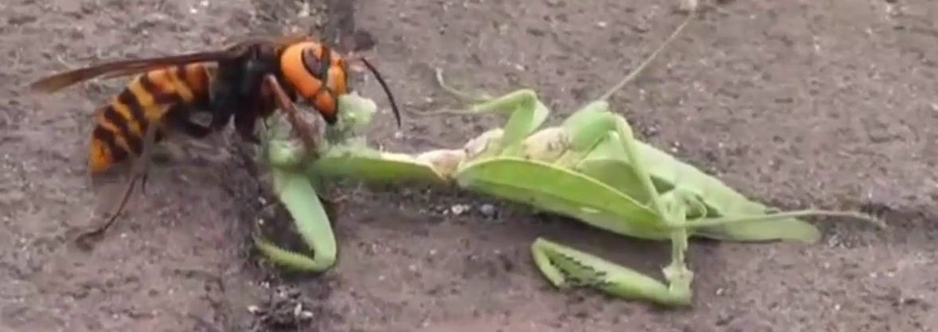
Report from diffraction break-out sessions
Mantid 4
Felt it was a bit hard to give feedback at this early stage (only 1D plot to see)
Name suggestion : another bug ?
Giant Hornet

Slide 2
Mantid 4
Layout
General feeling was it is OK to keep it close to what it is now.
Suggestion about having a journal viewer like entry to mantid (can then search by PI, sample,
etc…) easy plotting of the logs. A la “Addie” ?
Would be good to have not just a WorkSpace window but also a PlotSpace.
Sometimes tens of plots are present. Make it easier to see what workspaces are associated with
what plots (so overlay easier). Colour coding ? Mini icons when hovering over?
SaveProject does not work properly (plots do not reappear as saved). Sometimes crashes
And/or incredibly slow as it saves nxs files which can be huge. Save only reduced data option or
ability to turn off some features of the nxs (the whole geometry which makes the file huge)
but keep a tag history so it can be re-processed if needed.
Editor not really good enough. Indentation very important in python but hard to see in
current editor also no debugging possible. Some groups make their own python codes but
want to retain mantid functionality. Apparently possible already to link pyCharm, Spyder but
Users are not aware how to do it. Need to document and make it easy to see from editor window.
How to deal with Depreciation ?
Current proposal OK but need robust testing. Automated reporting to prevent last minute panic.
Depreciation should not pop up every time mantid is started (option to turn off in preference)
Need ability to print script and mantid log messages.
“Auto” lines at top : OK

Slide 3
Mantid 4
Plotting
Active/Hold OK but need more interactivity. Also from pull down menu.
KEEP the drag and drop please.
Play/Stop yes please
Consensus to keep it simple but have a well designed AND easily accessible gallery for more
fancy plots (multiple plots with single x-axis, plot with inserts, etc…).
History with ALL the attributes of a current plot should be accessible (so can be easily modified
and also users can save their favorite custom plots).
Multiple 2D workspace plots : both single fig in subplots or multiple figures are useful.
Essential features : being able to do everything we can currently do (incl waterfall plots, surf plots
Python 3 : too early to have views, but understand it is needed. Lets focus on mantid 4 first, we
can probably learn lessons from move over to Mantid 4.

Slide 4
WishLists
GENERAL
Core team : view that it is a good thing for code sustainability.
Project management : seems some projects are similar and happening in parallel :
How much discussions are there to start projects (long ones, not bug fixes)?
Mechanism to these inter facility projects? Come up with a way to track projects and
improve cross-facility knowledge transfer. Part of role of Core team ?
Reduce number of algorithms to combine common ones e.g. absorption correction.
Happy to see progress over the past year on individual items.
POWDER
Top priority : make ConvertUnits work properly (ie use calibrated positions rather than
Idf). This is very counter intuitive.
Calibration and Data Reduction: Some work has been done but no harmonization.
Need comparison for both facilities so 1- User documentation needs to be more obvious.
2- Make scripts and calibration data available.
Absorption and multiple scattering : also some work done but again documentation and
some overview across facilities and techniques of what works and how is needed.
Total Scattering (2017 goal: Replace Alan’s code). Progress and some talk cross facility mostly
Inst. Sc. level. Need benchmarking (GudRun can read our nexus files to benchmark new code).
Multidatasets Fitting: example where things have been done but seemingly little cross facility
Talk. This is also cross technique (muon). Too late to act? Can reuse some of SNS code for ISIS ?
Bugs fixes : PEARL reports masking funny (shift) and hard to do (eg SX peaks)

Slide 5
WishLists (2)
SINGLE CRYSTAL
Progress made but still a long way off what the Xray community have.
The two main developers are actually discussing. ☺.
Graphical Interface is a priority for SNS, especially interactive interfaces are critical for
TOPAZ for quick and efficient screening of samples (1h Mantid vs 10 minutes Isaw). Need to
find out where were the stumbling blocks are : Exchange of how the code is used.
Overlay hkl grid onto q-space (in slice viewer and VSI).
Incommensurate structures. Some progress and facilities aware of each other. Need
fundamental change in mantid for PeaksWorkspace (not just 3 D anymore). Priority for ISIS.
Need multiple UBs to deal with twinning.
Sample shape dependent corrections. Both facilities would like this. Some elements (MC)
already in Mantid apparently ? Docs.
Need to spend time to look at what can be taken from nsxtools (esp. corrections, integration
of weak peaks) and incorporated into mantid (through student & mantid team?).
Bug fixes : edge integration (too much rejection)
Xtal planner (Corelli starts to use it, port to WISH should be easy). Better awareness cross facility.
ENGINEERING/IMAGING
Different projects at SNS and ISIS. SNS imaging does not use mantid for Imaging.
Noted progress in imaging in Mantid. Fine to leave final bit to TomoPy. How to port stuff that
Tino has done in roots to mantid ?
Wenduo is working on inverse pole figures.
Merge V-drive with the ISIS efforts for multibank fitting (and eventually pole figures)?
Next : Bragg edges ?

